Slide 1
Single Crystal Turbine Blades

Slide 2
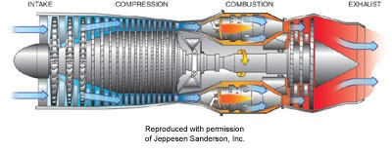
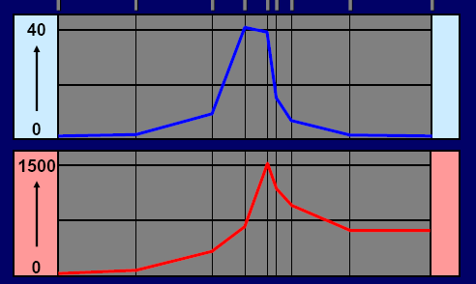
Jet Engine
Pressure
(atmospheres)
Temperature
(degrees C)

Slide 3
Material requirement: Jet Engine
Turbine blades in a jet engine experience:
  Creep
  Fatigue
  Thermo mechanical fatigue
  High temperature environment
  Oxidation
  Hot corrosion
Boeing 747 civil aircraft: 10,000 rpm, 20 tonnes per square inch outward pull, 10,000 hours
High engine efficiency is unconditionally desirable because higher efficiency means more complete fuel combustion, which saves fuel cost and reduces emission of greenhouse gases

Slide 4
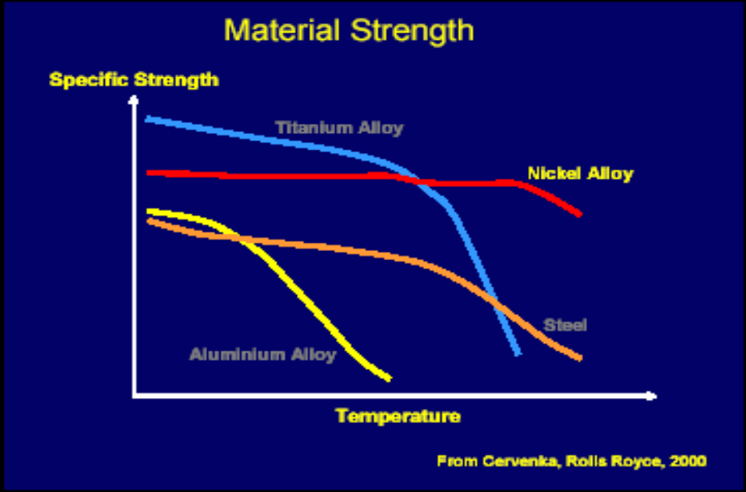
Turbine blade Material: Options
Conventional
Ni-based super alloys offer the best durability and specific strength over a much larger range of temperatures compared to other super alloys
They have very long creep rupture life since the lattice mismatch between two dominant FCC phases (γ & γ’) is less than 1%. The chemical stability of the material and close lattice match between the phases have also led to homogeneous precipitation of γ’

Slide 5
Turbine blade Material: Options
Conventional
One way is by creating gas flow ducts within the blades so that the interior of the blades can be cooled by about 100 deg C when the turbine comes in contact with the fast flowing gases. Ceramic cores are introduced into the molten super alloy to create the ducts while the turbine blades are cast.
Another way to improve the oxidation or hot corrosion resistance of turbine blades is by covering the blades with thin thermal barrier coatings. The thermal layers are often NiAl-based materials (50μm), (Ni/Co)CrAlY (100-200μm), or ceramic materials such as Zirconia (300-400μm). Thermal barrier coatings can confer up to an additional 150 deg C temperature tolerance.

Slide 6
Turbine blade Material: Options
Directionally-solidified (DS) materials formed by controlled cooling and solidification directionally from bottom to top. Columnar grains are formed parallel to the <100> growth axis in the Ni-based super alloy.
Single Crystal blades are free of high angle grain boundaries and hence the melting point of the turbine blades drastically increases.
SC blades are made in almost the same fashion as DS blades except that the mold is drawn through a corkscrew-shaped ‘pigtail’ coil using a seed crystal as starter. Only the grains that grow quickly and with the preferred orientation will survive as they attempt to thread the twists of the coil such that one crystal will eventually prevail.

Slide 7
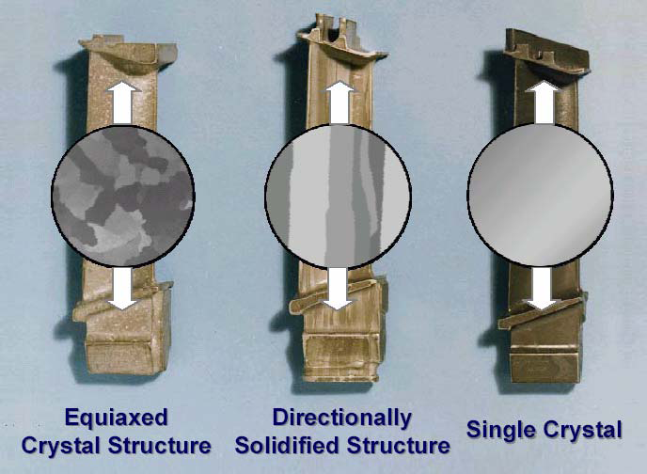
Why Single Crystal?
Longer thermal and fatigue life
More corrosion resistant
Can be cast with thinner walls hence
less material and less weight
Higher melting point temperature.
These improvements all contribute to higher efficiencies
.

Slide 8
How it Works?
Coarsening
Coarsening is driven by surface energy. The surface to volume ratio for a spherical particle is 3/r where r is the particle radius. The particle therefore has an extra energy of 3σ/r where σ is the interfacial energy per unit area. To minimise coarsening it is necessary to reduce the interfacial energy.
Nickel base superalloys are two phase mixtures containing 40% γ and 60% γ’. The γ is a disordered mixture of Ni and Al atoms with a c.c.p. crystal structure. The γ has a stoichiometric composition Ni3Al with a primitive cubic crystal structure with a motif of an aluminium atom at [0,0,0] and three nickel atoms at [0, 1/ 2 , 1 /2 ], [ 1/2 ,0, 1/2 ] and [ 1/2 , 1/2 ,0]. The two phases are in a cube–cube orientation, i.e. their cell edges are exactly parallel. They are coherent.
The coherency is important because it implies a small interfacial energy and hence a reduced tendency to coarsen during exposure at elevated temperatures.
Titanium is added to form Ni3(Al, Ti). The ratio of Al/Ti therefore determines the lattice parameter of γ, and can be adjusted to give coherency with γ.

Slide 9
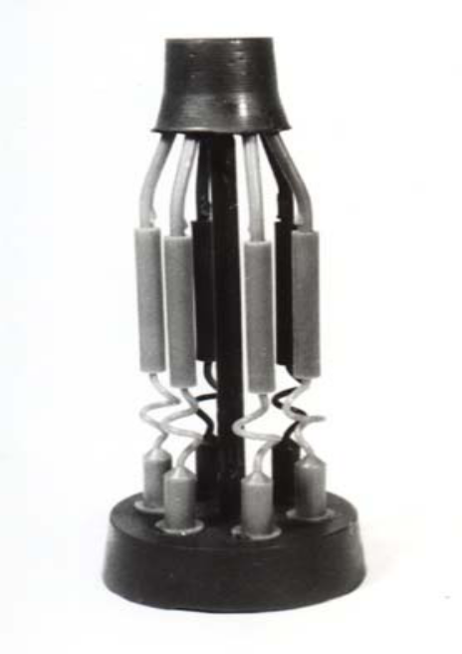
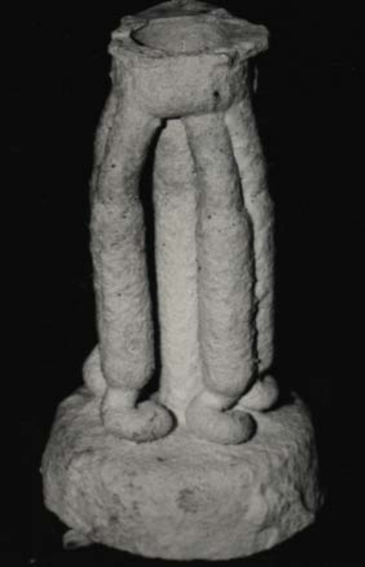
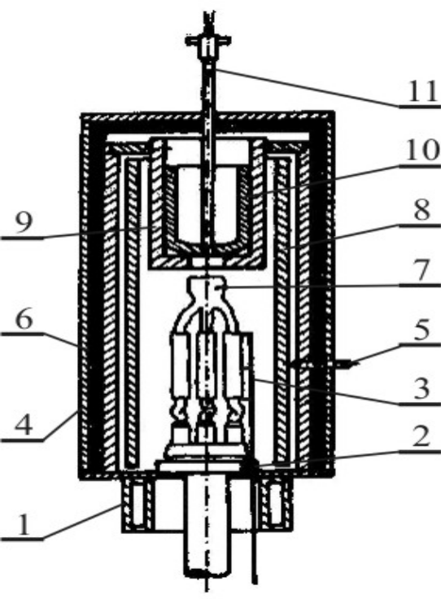
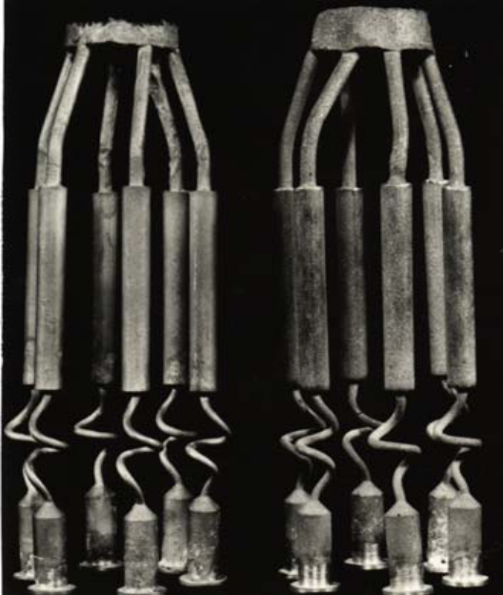
Production Process
Wax pattern
Ceramic shell mould
1-Cooler 2-mobile table 3-Thermocouple 4- covering of hot chamber, 5- measuring the temperature of chamber, 6- thermal isolation, 7- ceramic shell mould, 8- heating unit, 9- support, 10- melting crucible, 11- measuring the temperature of molten alloy
SC CMSX-3 Ni Sup Alloy

Slide 10
Applications
Jet Engine
Gas Turbines for Power plant
Nuclear Reactor
Rocket engines
Space vehicles
Submarines
Military electric motors
Chemical processing vessels
Heat exchanger tubing.

Slide 11
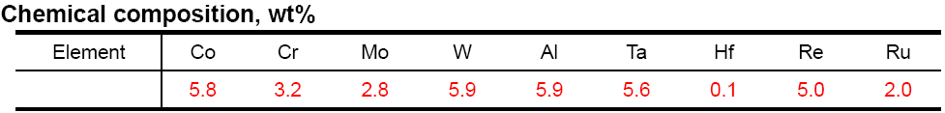
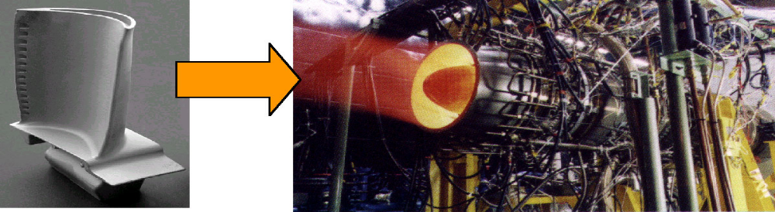
Application
TMS-138
A 4th generation nickel-base single crystal super alloy with superior high temperature creep strengths and the stability of γ/γ' two phases. The creep tests showed that the alloy has a good balance of creep strength over this temperature range; typical rupture lives at 900 deg C-392 MPa and 1100 deg C-137 MPa being 986.9 h and 412.3 h, respectively. Also, TMS-138 alloy has very good hot corrosion resistance as well
At ESPR project*, endurance test of HTCE (High Temperature Core Engine constructed employing TMS-138 super alloy) was successfully conducted at 1650°C turbine inlet temperature that is the highest level in the world.
*ESPR project ： Research and Development of Environmentally Compatible Propulsion System for Next-generation Supersonic Transport (organized by New Energy Development Organization in Japan).

Slide 12
Material Examples
TMS-138
EPM-102
CMSX-4
RR3000
ReNe 4

Slide 13
What Next?
It is estimated that over the next twenty years a 200°C increase in turbine entry gas temperature will be required to meet the airlines' demand for improved performance. Further increases in temperature are likely to require the development of ceramic matrix composites
An early example of such a system is alumina fibres in an alumina matrix.
To realize the ultimate load carrying capabilities at high temperatures, single crystal oxide fibres may be used. Operating temperatures of 1400°C are thought possible with these systems.

